Slide 1
Section 6.2
Different Forms of Complex Numbers
© Copyright all rights reserved to Homework depot: www.BCMath.ca

Slide 2


Ex: Given that z₁ and z₂, what is the value of $\overline{z1+z2}$ ?
Ex: Given that z₁ and z₂, what is the value of $\overline{z1×z2}$ ?

Slide 3
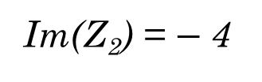
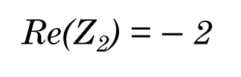
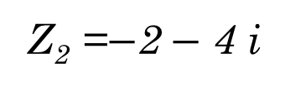
I) Intro to Drawing Complex Numbers:
Every complex number has a “real” component and a “imaginary” component
The real component Re(z) is drawn on the “X” axis of a complex plane [REAL axis]
The imaginary component Im(z) is drawn on the “y” axis [Imaginary Axis]
Z₁ = 4 + 3i
Z₂ =$−$2$−$ 4 i
Re(Z₁) = 4
Re(Z₂) = $−$2
Im(Z₁) = 3
Im(Z₂) = $−$4
When drawing a complex number, two things that are important:
1. The length of a complex value
2. The angle of the value
KEEP IN MIND:

Slide 4
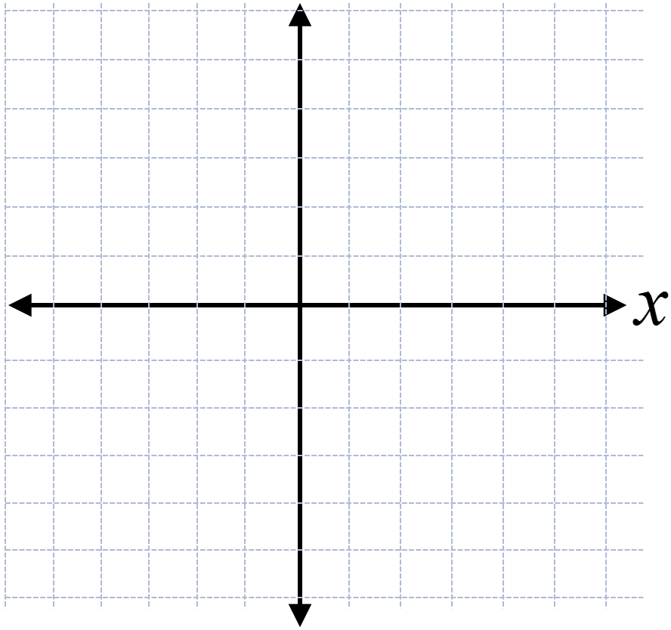
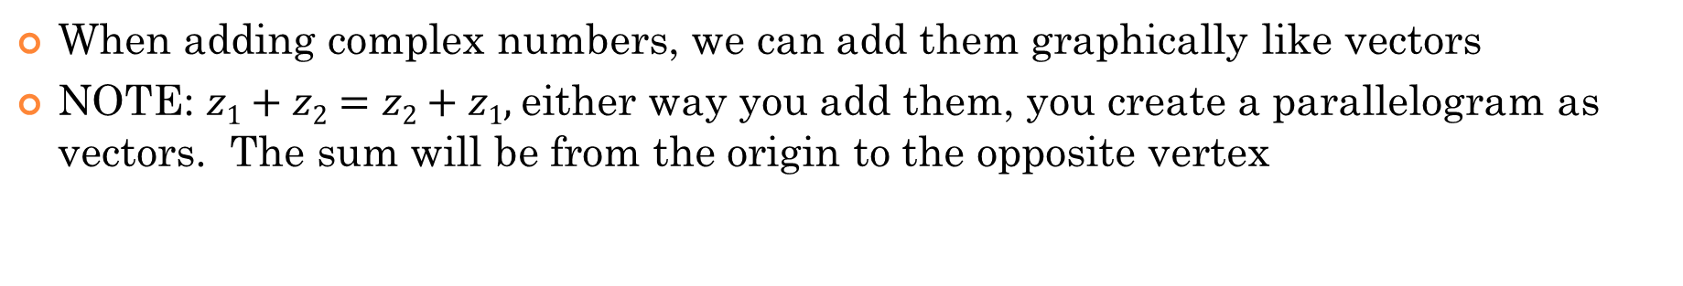
Adding Complex Numbers Graphically:
When adding complex numbers, we can add them graphically like vectors
NOTE: $z1+z2=z2+z1,$either way you add them, you create a parallelogram as vectors. The sum will be from the origin to the opposite vertex
Draw Z2 from the the end of z1
Likewise, if we were to add z1 to z2, we would draw z1 from the end of z2
Note: When adding complex numbers, the associative property applies [The order does NOT matter!]

Slide 5
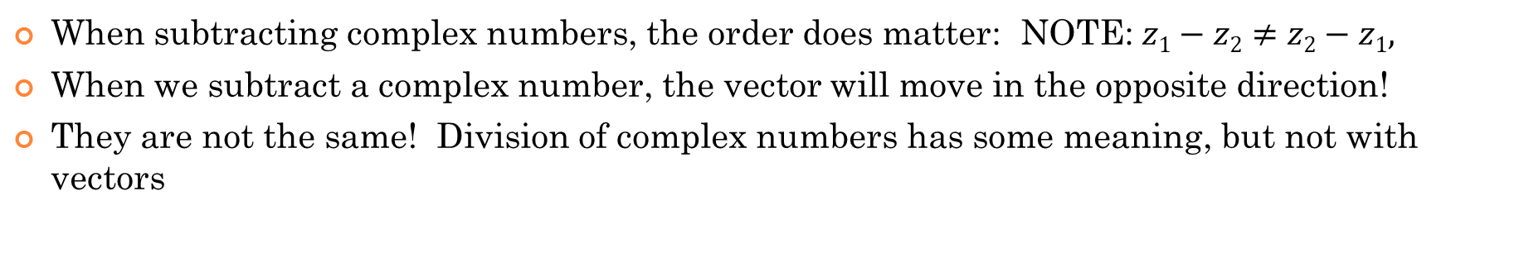
Subtracting Complex Numbers Graphically:
When subtracting complex numbers, the order does matter: NOTE: $z1−z2≠z2−z1,$
When we subtract a complex number, the vector will move in the opposite direction!
They are not the same! Division of complex numbers has some meaning, but not with vectors
When subtracting complex numbers, draw the 2nd complex number from the end of the first complex number, but pointing in the opposite direction!
Likewise, if we were to switch the complex numbers and then subtract them, our difference will be different
Keep this in mind. They are NOT equal!
Instead, one is a 180 degrees rotation from the other!!!

Slide 6
Rotating a Complex Value by 90 degrees:
Q: When happens to a complex number graphically when it is multiplied by “i”?
Answer: it rotates 90 degrees counter clock wise on the Complex Plane
[aka: Argand plane]
Keep this in mind: When you multiply “z” by i, it rotates by 90 degrees
When you multiply “z” by i², it rotates by 180 degrees
When you multiply “z” by i³, it rotates by 270 degrees
When you multiply “z” by i⁴, it rotates by 360 degrees

Slide 7
Ex: Given the two complex values: Draw & find the following
a) z₁ + z₂ b) z₁ – z₂ c) z₂ – z₁
When subtracting complex numbers, it’s important to note which is being subtracted

Slide 9
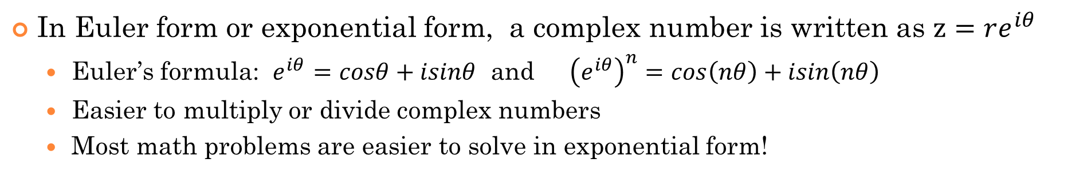
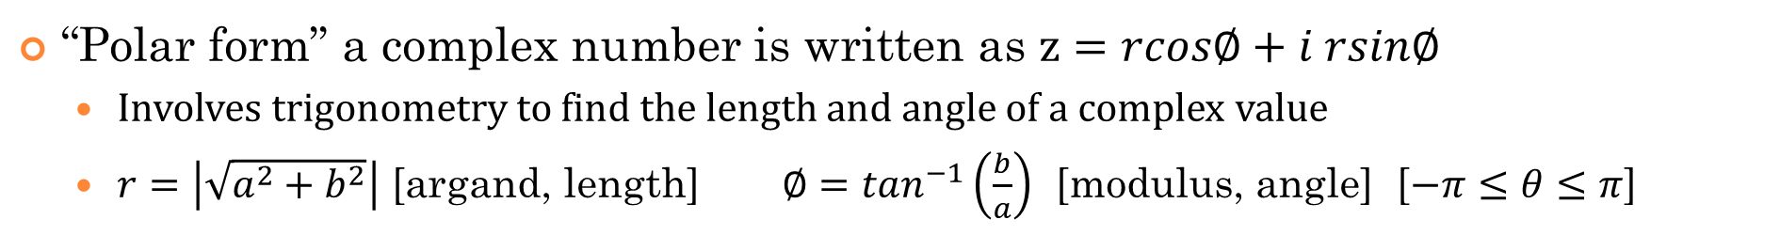
Forms of Complex Numbers: $z=a+ib z=rcos∅+irsin∅ and z=re^{iθ}$
There are 3 Main forms of complex numbers:
“Standard Form”, a complex number is written as $z=a+ib$
  Easier to add or subtract complex numbers in standard form
“Polar form” a complex number is written as $z=rcos∅+i rsin∅$
  Involves trigonometry to find the length and angle of a complex value
  $r=\left|\sqrt{a^{2}+b^{2}}\right|$ [argand, length] $∅=\tan^{−1}\left(\frac{b}{a}\right)$ [modulus, angle] [$−π≤θ≤π$]
In Euler form or exponential form, a complex number is written as $z=re^{iθ}$
  Euler’s formula: $e^{iθ}=cosθ+isinθ$ and ${\left(e^{iθ}\right)}^{n}=cos\left(nθ\right)+isin\left(nθ\right)$
  Easier to multiply or divide complex numbers
  Most math problems are easier to solve in exponential form!

Slide 10
II) Complex numbers in Polar Form:
In circular geometry, the “x” coordinate of any point on an unit circle is $r×cos∅$ and the “y” coordinate is $r×sin∅$, therefore we have:
In polar form, “r” is called the “modulus” , “radius”, or “length” of a complex number
The “angle” [aka: argument] is the direction of the complex number and MUST be between $−180°$ to $180°$
POLAR FORM:

Slide 11
Practice: Given “z”, find argZ
Note: ArgZ is created with the positive “real axis”
The argument of “z” is always between [$−π,π$]

Slide 12
Practice: Find the modulus “r’ and argument “argZ” for each complex number

Slide 13
iii)Converting Comp. Numbers to Polar form
Modulus,
modZ
Argument,
argZ
Ex: Convert -3+2i to the form r(cosϴ +isinϴ)

Slide 14
Practice: Convert -2-4i to the form r(cosϴ +isinϴ)
Practice: Convert 3(cos120°+isin120°) to a+ib

Slide 15
Graphing the product of Complex numbers
Complex numbers are easier to multiply when converted to polar form r(cosϴ + isinϴ)
PRODUCT of two complex numbers
Multiply the
two modulus
Add the two arguments
DIVISION of two complex numbers
Divide the
two modulus
Subtract the
two arguments

Slide 16
Proof: PRODUCT of two complex numbers
Verify:
Polar form:

Slide 17
Taking a Complex Number to a Power:

Slide 18
Ex: Given the graph of z₁ and z₂, graph z₁$×$z₂ and z₁$÷$z₂

Slide 19
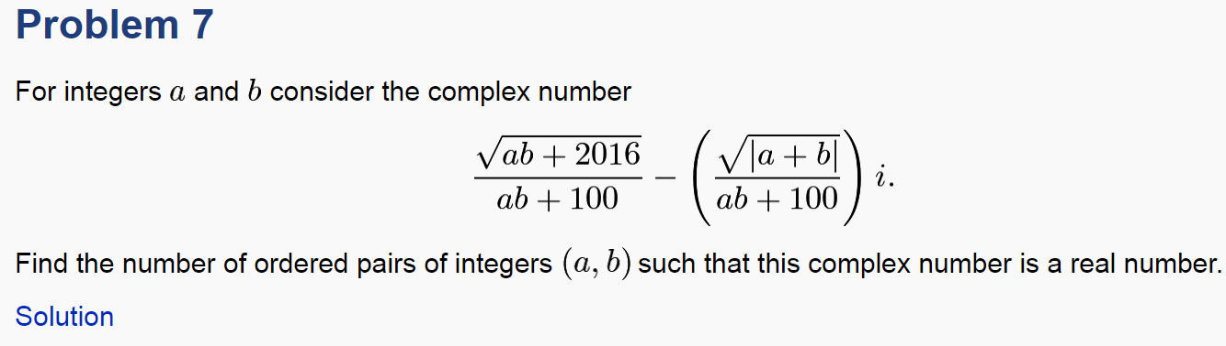
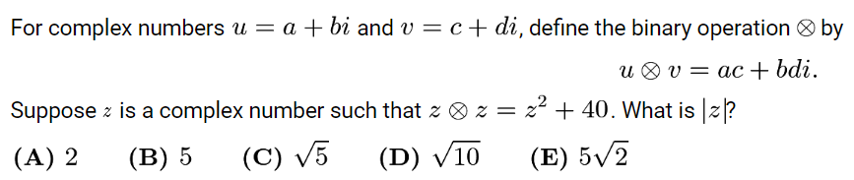
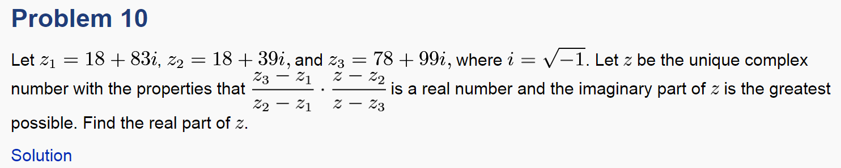
Ex: Given $z1=3+2i$ and $z2=2\left(cos\frac{π}{3}+isin\frac{π}{3}\right)$
Find z₁$×$z₂ and z₁$÷$z₂ in the form $r\left(cosθ+isinθ\right)$

Slide 20
2016 aime 1

Slide 22
Note: z=a+ib
The expression
only has a real component
The goal is to find the largest value of “b” possible

